Slide 1
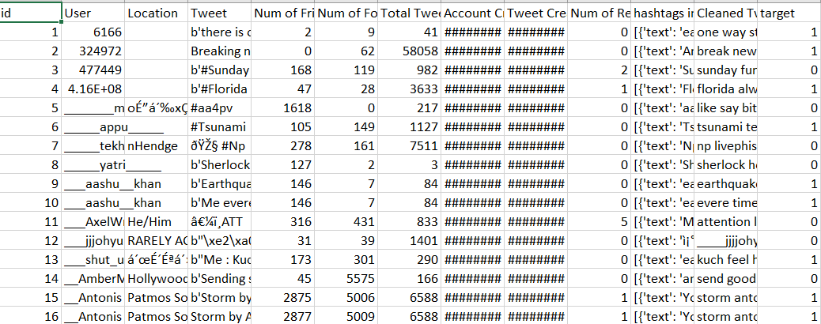
NLP Crisis Informatics project
Dataset

Slide 2
Preprocessing Steps and Results
Exploring Length of tweets v/s Number of Tweets
Exploring Number of words v/s Number of Tweets
Missing Data Analysis and filling
Removing URL & Special Characters
Tokenization
Glove Vector Embeddings
Models | Accuracy Rate
Logistic Regression | 98%
Naive Bayes | 97%
RNN | 96%
GRU | 97%
Deep LSTM | 96%
BERT | 99%

